Slide 1
This We Believe: So What? Living the Confession of Faith
Pastors’ Credentialing Orientation 2016
Brian Cooper

Slide 2
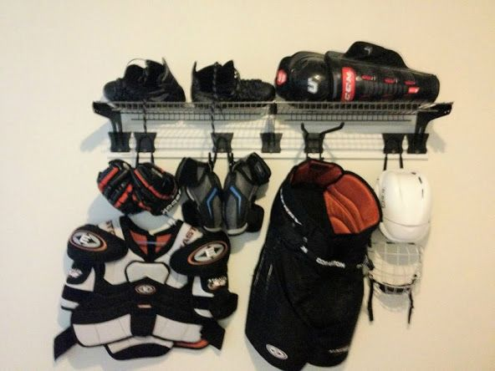
What Does the Confession of Faith Do for Us?
Resourcing
For mission
For ethics
For worship
Enablement
Gives clarity in theological matters
Protection
Addresses potential blind spots

Slide 3
Why Do We Need a Denominational Confession?¹
Accountability
Every church and every pastor of a local church needs accountability
This often requires a voice from outside the local church
Denominational confessions are part of the structure that maintains theological harmony, with policies and processes that administer it
1. Adapted from Jason Helopoulos, “In Praise of Denominations” https://blogs.thegospelcoalition.org/kevindeyoung/2012/12/28/in-praise-of-denominations/

Slide 4
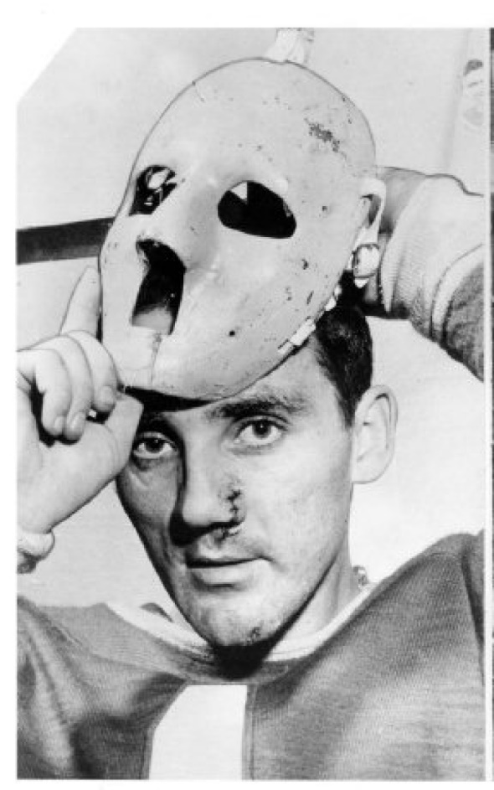
Why Do We Need a Denominational Confession?
Safeguarding Church Leadership
Leaders can be the greatest harm or blessing to a local church and its people
Churches need a rigorous, time-tested, biblically faithful standard for evaluating compatibility
Credentialing using a confession of faith provides a standard for discerning church leaders

Slide 5
Why Do We Need a Denominational Confession?
Safeguarding Congregations
Congregations need confessional unity to help define theological self-identity
A congregation in conflict with its leadership needs a theological reference point
Churches need something in common in order to have healthy relationships with one another

Slide 6
Why Do We Need a Denominational Confession?
Unified Confession
A congregation should also expect clarity in theological convictions based upon the denominational confession
A mutually agreed-upon confession helps remind us who we are as denominational Christians
A confession can foster common theological identity in relation to other congregations and other groups outside the denomination

Slide 7
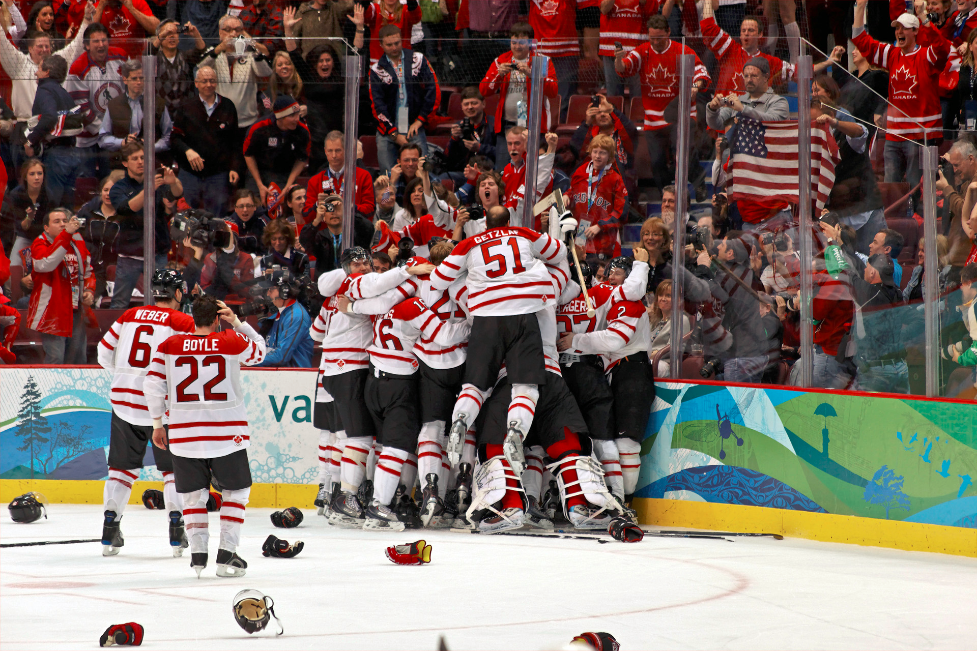
Why Do We Need a Denominational Confession?
Unified Mission
Clearly defined theology identifies not only identity (who we are in Christ), but also mission (what we are called to do as a result)
Our confession speaks to how we faithfully live the example of Christ in specific types of circumstances
Discipleship is as much about what we do as it is about who we are

Slide 8
How Does the Confession of Faith Work?
The Confession as a Living Witness to Scriptural Teaching
Confessions grow; they are not static
1902, 1975, 1999
Theological conversations are ongoing
Study Conferences
Pastors’ Equipping Days

Slide 9
How Does the Confession of Faith Work?
The Confession as an Example of Theological Resourcing
Our commitment is to theological equipping for ministry
Mennonite Brethren Biblical Seminary (http://www.mbseminary.ca)
Formal seminary programs
Church/institutional partnerships
MinistryLift (http://ministrylift.ca)
L2L Leadership training (http://www.l2lnet.org)

Slide 10
How Does the Confession of Faith Work?
The Confession as an Example of Theological Resourcing
Our commitment is to theological equipping for ministry
BFL pamphlets and theological papers
http://www.mennonitebrethren.ca/resource/faith-and-life-pamphlet-series
Resources for Theological and Historical Awareness
Direction Journal (http://www.directionjournal.org)
Centre for Mennonite Brethren Studies (http://cmbs.mennonitebrethren.ca)

Slide 11
What Happens When We Disagree?²
Enter fellowship believing that the Spirit of God has been at work among the Christians you are joining
If you cannot believe this, then you probably need to rethink why you are joining
Find out what contributed to the theological shape of the denomination and its confession
2. Adapted from Collin Hansen, “Chandler, Horton, Keller on How to Disagree” https://www.thegospelcoalition.org/article/how-to-disagree

Slide 12
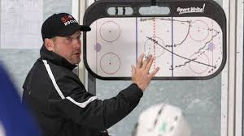
What Happens When We Disagree?
Enter with a desire to learn new things in your new ministry context
In ministry, as in other areas of life, when we cease to learn, we begin to die.
Learning from those we are close to is a virtue, and a necessary ingredient if we want them to learn from us.

Slide 13
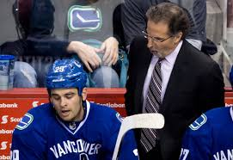
What Happens When We Disagree?
Remember that disagreement is inevitable, but it is not fatal — unless we make it so
Think of Paul and John Mark
Think of your last ministry setting
Disagreement and conflict can be productive
“As iron sharpens iron, so one person sharpens another.” Proverbs 27:17 NIV

Slide 14
What Happens When We Disagree?
The most fruitful and faithful way to address disagreement is in relationship
“Christians in community are to never give up on one another, never give up on a relationship, and never write off another believer. We must never tire of forgiving (and repenting!) and seeking to repair our relationships.” – Tim Keller

Slide 15
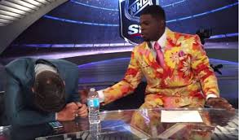
What Happens When We Disagree?
Represent those with whom we disagree at their best
They should recognize themselves in our characterizations
Otherwise we are interacting with a straw man rather than a person

Slide 16
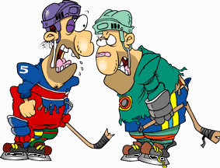
What Happens When We Disagree?
Let us be careful about speaking up about what we do not know well
It is much easier to have an opinion than to discern
Leaders have a great responsibility to model godliness, especially when teaching
“Not many of you should become teachers, my fellow believers, because you know that we who teach will be judged more strictly.” James 3:1 NIV

Slide 17
What Happens When We Disagree?
Christlikeness requires submission
To God’s direction
To others
To the theological discernment of the body as seen in the Confession of Faith

